Slide 1
Skill Tracker
Group No. 4 (Justice League)
PRESENTED ON - 31/07/2019
SHARATH CHIDRE (14427)
YUSUF SONI (14448)
NIDHI MEHTA (14430)
NEHAL PAWAR (14435)

Slide 2
INTRODUCTION
Skill trackers are a useful tool in todays fast changing world of technology.
Our website consist of three main modules one module focuses on user centric operations, the other focuses on the admin centric operations, and the third being a login module.
The login module performs role based authentication.
Our skill tracker consists of a skill list with consist of a rating that indicates its demand in the current market.
A jobs list which the user can view to apply for jobs.
A courses list which the user can view to learn these new skills.
The admin can view all the above mentioned lists and add, delete and update the various lists.

Slide 3
INSIGHTS
Our project has been implemented using the following technologies:
FRONTEND | BACKEND
Angular – Created components and services | Springboot – Backend is implemented using springboot
HTML 5 – Designing webpages | Maven – Build tool to insert dependencies
CSS 3 – Styling of the webpages | Hibernate – Object Relational Mapping framework
Bootstrap – Making the webpages responsive | MySQL – Handling data

Slide 4
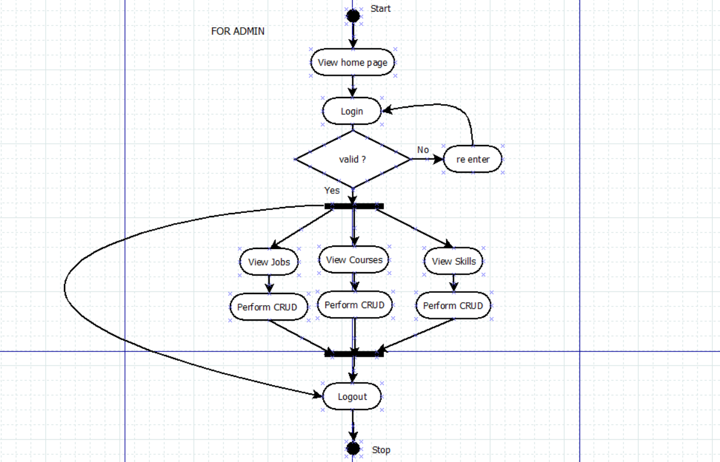
ACTIVITY DIAGRAM FOR ADMIN

Slide 5
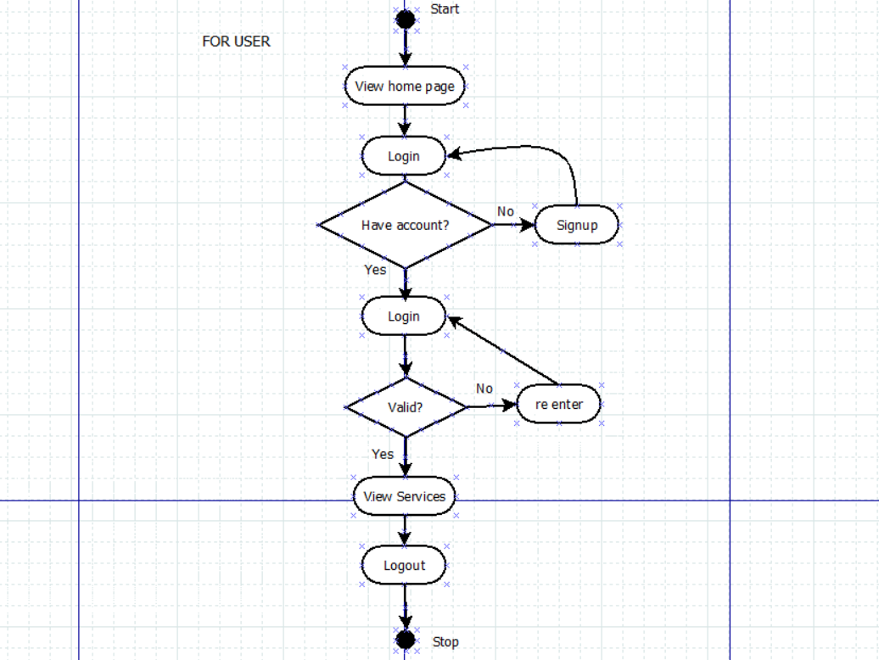
ACTIVITY DIAGRAM FOR USER

Slide 6
INNOVATION AND BUSINESS FEATURES
User can view the various trending technologies which will help him/her give their future a better shape.
A secured login for each and every user.
User can view jobs in a reputed company for a particular skill.
User can view best online courses for a particular skill thus enhancing knowledge in that field.
Visitor can know more about the technology by just clicking on the companies/skills logo which is navigated to the Wikipedia page.

Slide 7
Problems Faced | Cause | Solution
Problems in linking various components designed. | Wrong approach taken to design system. | Consulted the mentor and rectified approach.
Role Based Authentication not functioning. | Missing parameter in properties file. | Surfed the internet and found the missing parameter to be added.
Error in fetching data from tables. | Incorrect data format applied while fetching data | Mentor guided us to find solution.
Errors occurring due to violation of CORS Policy. | Incorrect path specified while routing. | Carefully scrutinized the code to make sure paths match.
Errors in fetching data across modules. | Incorrect objects and urls used. | Consulted our colleagues to rectify error.
Issues while updating entries in database. | Incorrect parameters being passed during function call. | Consulted colleagues to understand the proper syntax.
Images not getting rendered properly | Placed images in incorrect folder | Conferred with team members to arrive at solution.

Slide 8
Thankyou!

